Slide 1
TK8117: World Happiness Index
E.F. Prentice
12 December 2019

Slide 2
Problem
Can we predict human happiness based on societal factors?
Which factors affect happiness?
Do these factors contribute linearly to a happiness model?
If the model can predict happiness, how certain is it?
How can this be validated?

Slide 3
The Dataset
Calibration set: 2019, Validation set: 2018
X: 156 x 6
Y: 156 x 1
 | GDP per capita | Social Support | Longevity | Freedom | Generosity | Perceived Corruption
Country 1
Country 2
Country 3
Country 4
...
 | Happiness factor
Country 1 | 0-10
Country 2
Country 3
Country 4
...
Agreement score (1-10)
https://www.kaggle.com/unsdsn/world-happiness#2015.csv
Notes:
People rate on scale 6 characteristics 1-10, calculated to 0-1.85
Some missing data

Slide 4
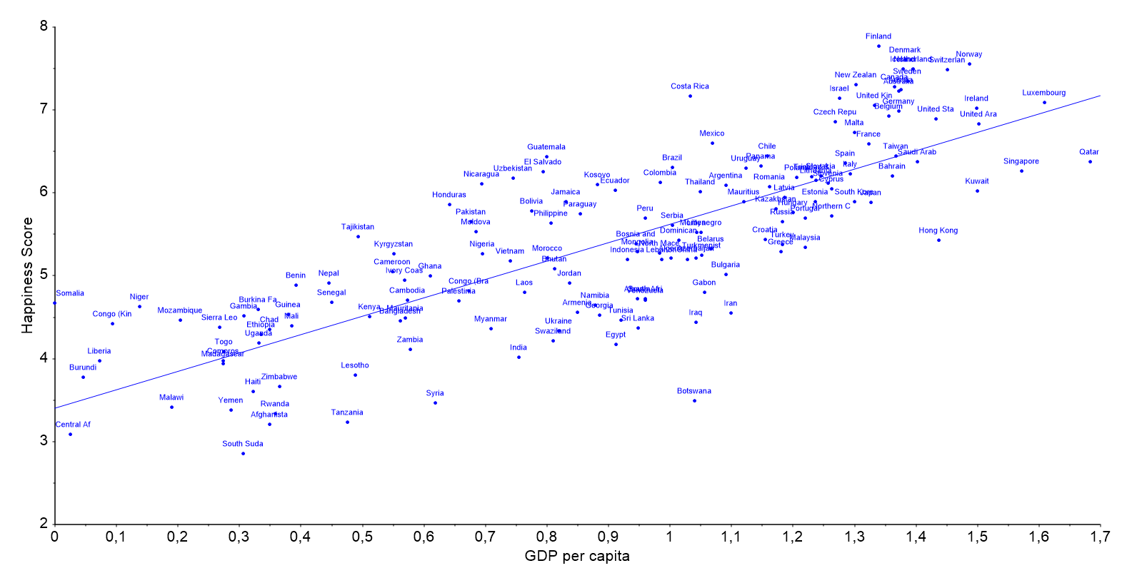
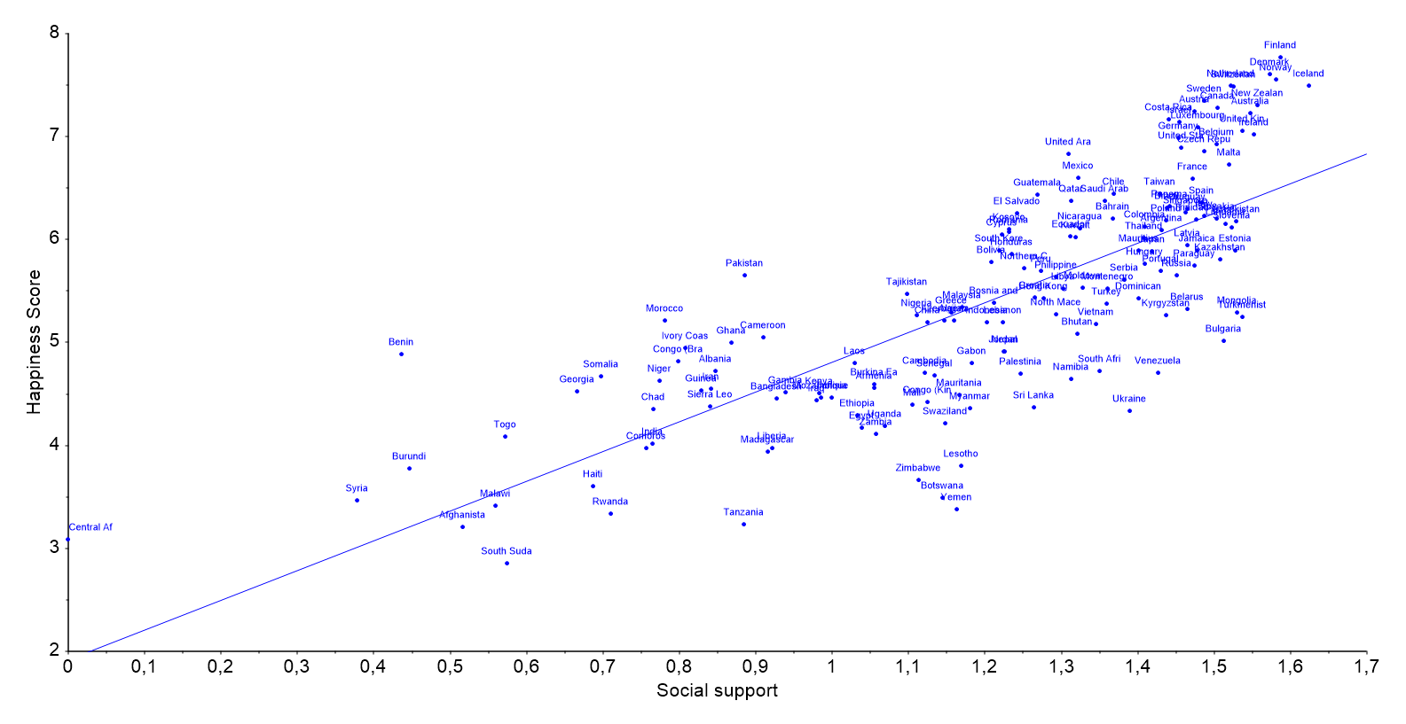
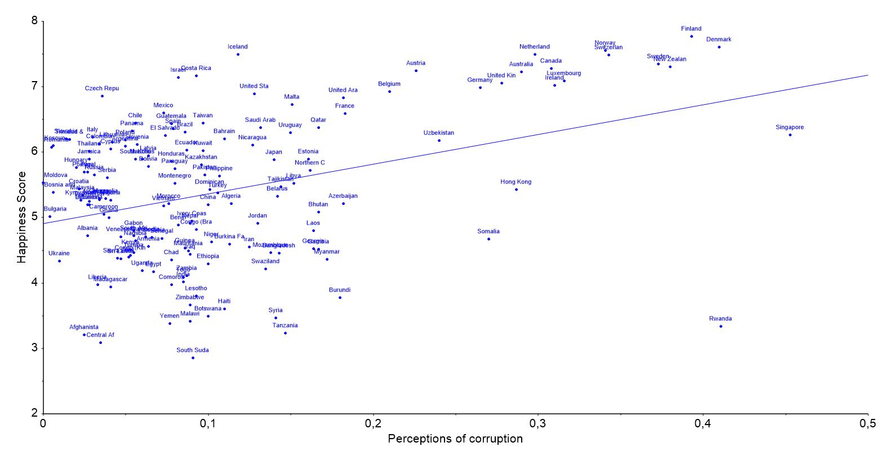
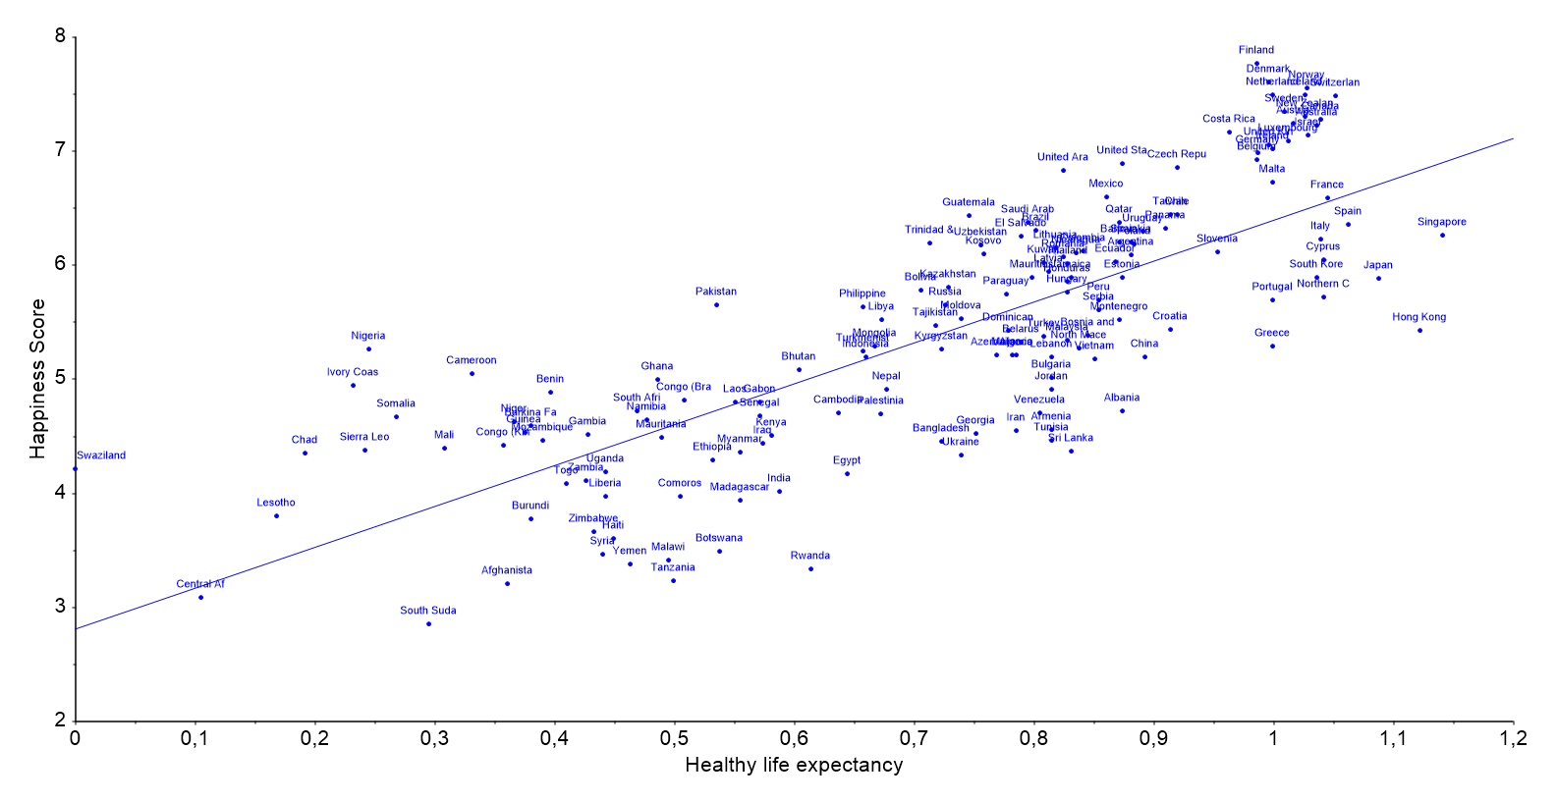
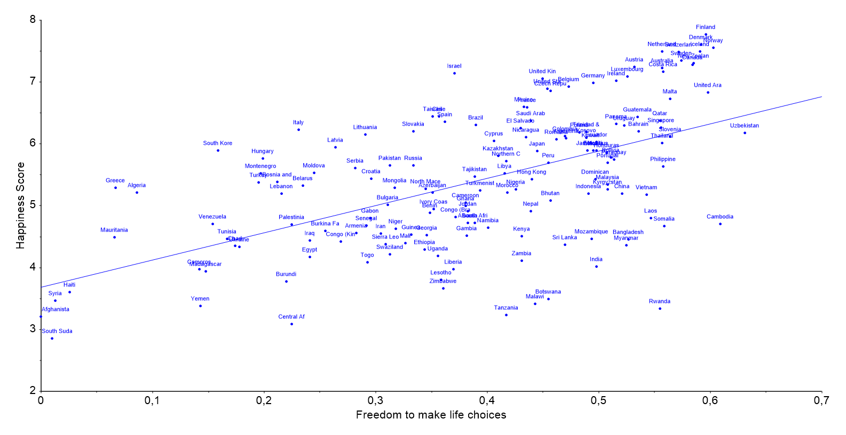
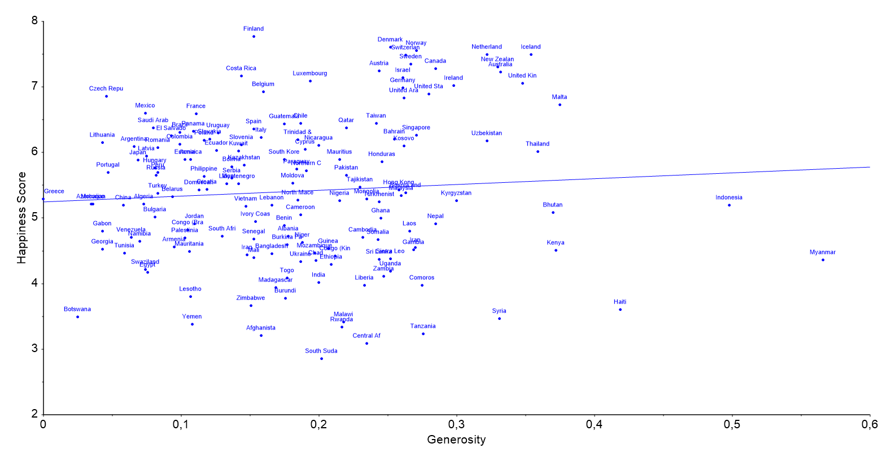
Linear or nonlinear?
Correlation
X-variable
0.794
GDP per capita
0.777
Social Support
0.386
Perceived Corruption
0.780
Longevity
0.567
Life Choices Freedom
0.076
Generosity
Assumption: happiness is dependent
Notes:
Assumption: happiness is dependent

Slide 5
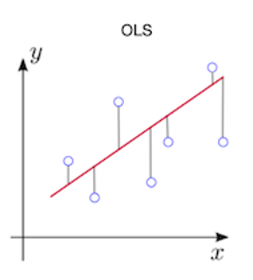

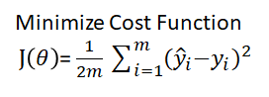

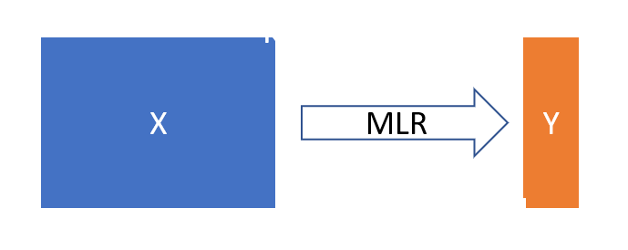
Multiple Linear Regression
MLR
[from Lecture 5]
Notes:
Aka ordinary least squares, Total least squares minimizes distance to fit

Slide 6
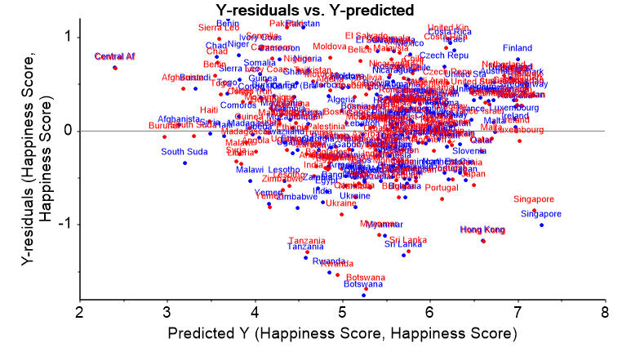
Multiple Linear Regression
Bias? doesn’t seem like it
Notes:
Is it biased?

Slide 7
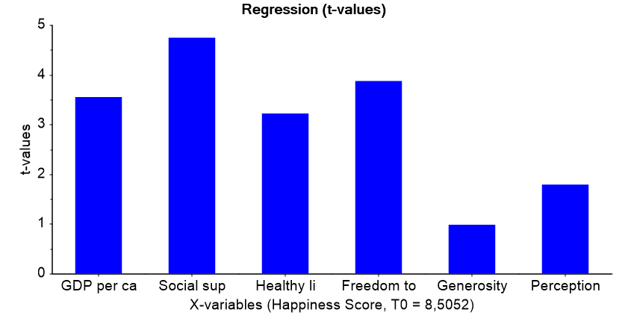
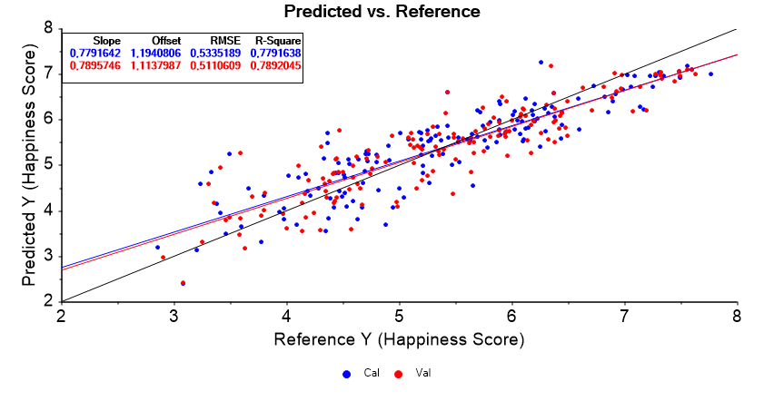
Multiple Linear Regression
Fit? P-value of model = 0.0000, linear model is valid
Notes:
t-value is ratio between (deviation from the mean accounted for by the variable represented by the coefficient / standard error of the mean)

Slide 8
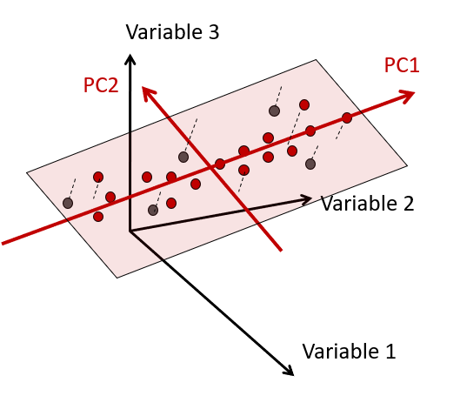
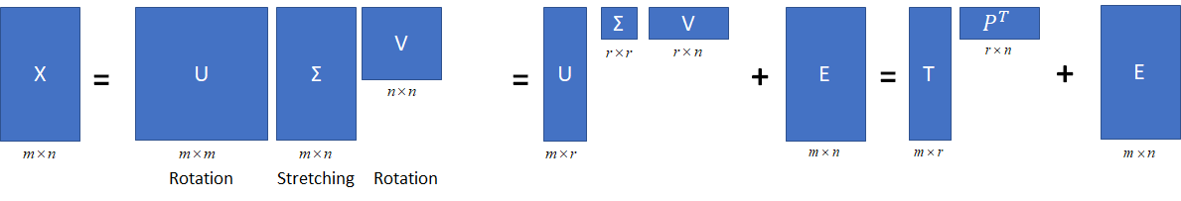
Principal Component Analysis
Simplification, variable selection
Compression
Outlier detection
Clustering / classification
Regression
Axis of largest variance
Linearly uncorrelated variables
[from Lecture 5]

Slide 9
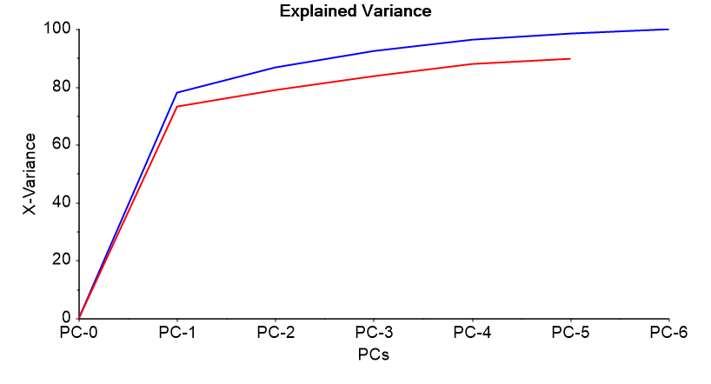
Principal Component Analysis
All 6 x-variables
Mean-centered
Equal weighting
Full x-validation
NIPALS (missing data)
78

Slide 10
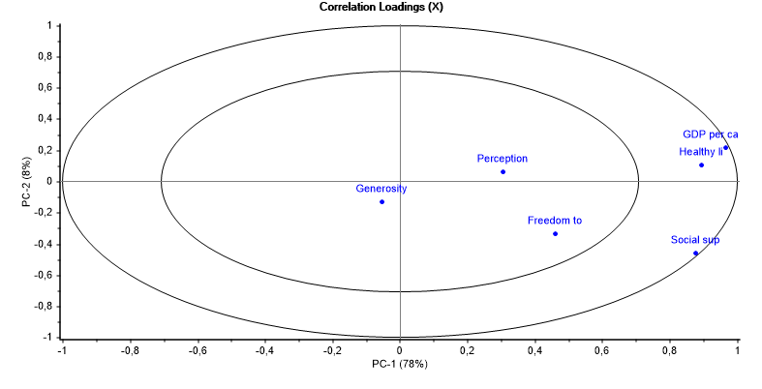
X-var Correlation?
Notes:
Large vs small influence on model - distance from origin
High correlation = angle between
PC1 vs PC2 …
Variable selection for regression modelling

Slide 11
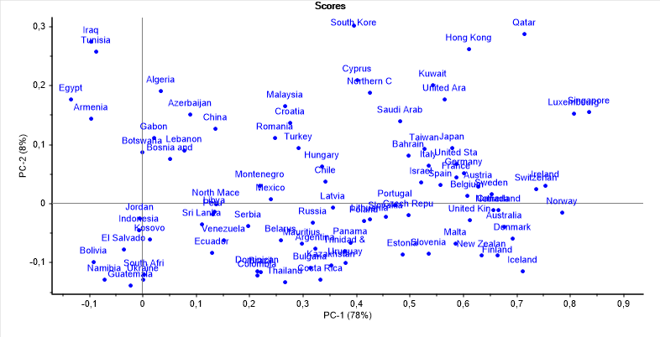





X-var Correlation?
$
Notes:
Large vs small influence on model - distance from origin
High correlation = angle between
PC1 vs PC2 …
Variable selection for regression modelling

Slide 12
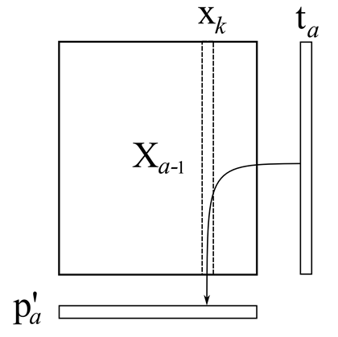
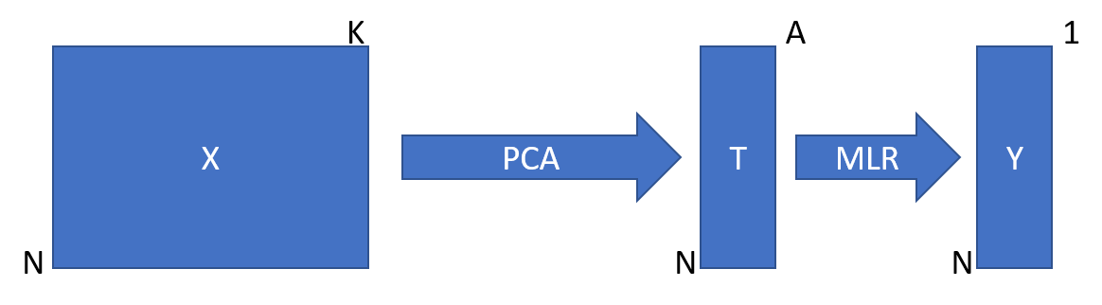
Principal Component Regression
NIPALS for PCR
Do PCA first
Regress on PCA
MLR
PCR
[from Lecture 5]
Notes:
Did not converge for 1/std weighting

Slide 13
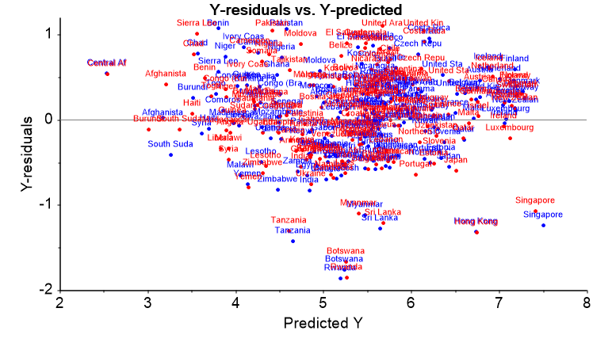
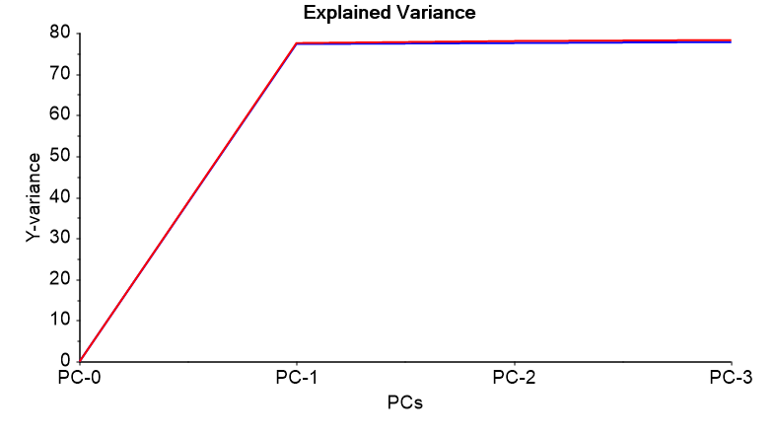
Principal Component Regression
Bias?
All 6 x-variables
Mean-centered
1/STD weighted
Validate w/ 2018
NIPALS (missing data)
78
Variance?
Notes:
Did not converge for 1/std weighting

Slide 14
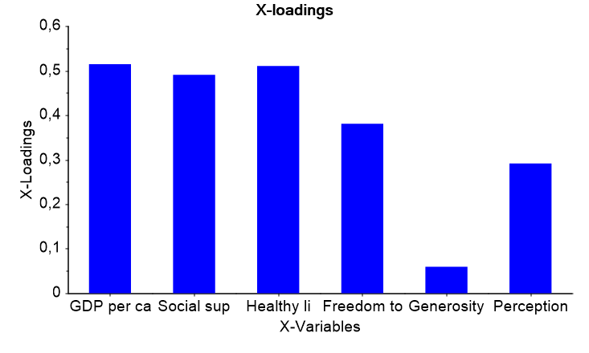
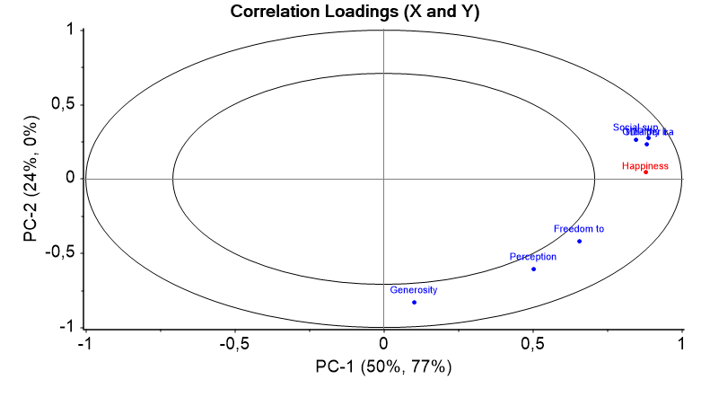
Principal Component Regression
Notes:
Did not converge for 1/std weighting

Slide 15
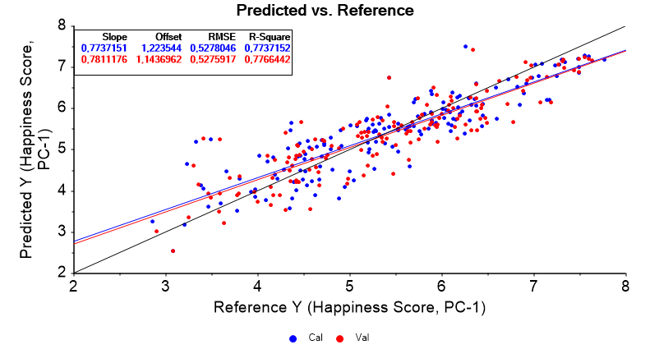
Principal Component Regression
Notes:
Did not converge for 1/std weighting

Slide 16
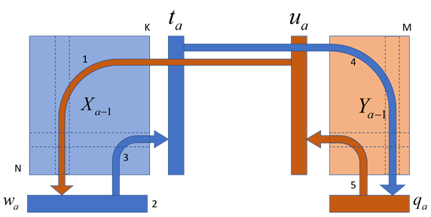
Partial Least Squares Regression
NIPALS for PLSR
Use PCs to predict response and vice versa
Then regress on final PC
PCR
PLSR
MLR
[from Lecture 5]

Slide 17
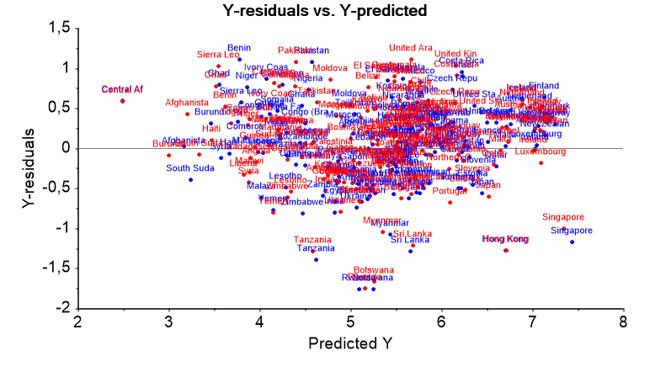
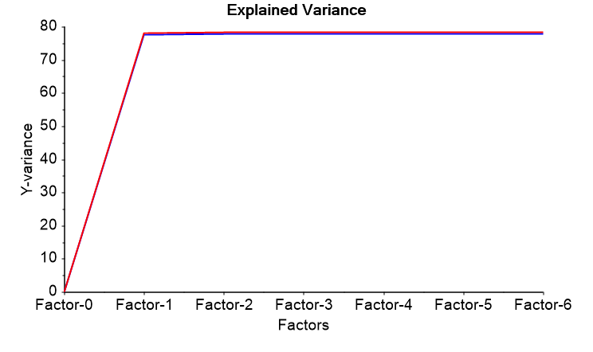
Partial Least Squares Regression
Bias?
All 6 x-variables
Mean-centered
1/STD weighted
Validate w/ 2018
NIPALS (missing data)
78
Variance?
Notes:
Did not converge for 1/std weighting

Slide 18
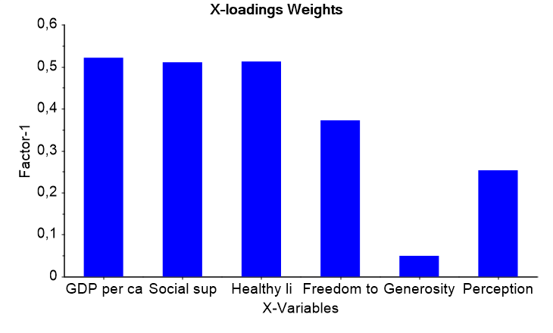
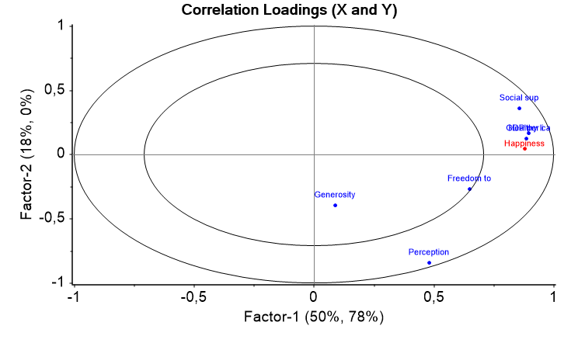
Partial Least Squares Regression
Notes:
Did not converge for 1/std weighting

Slide 19
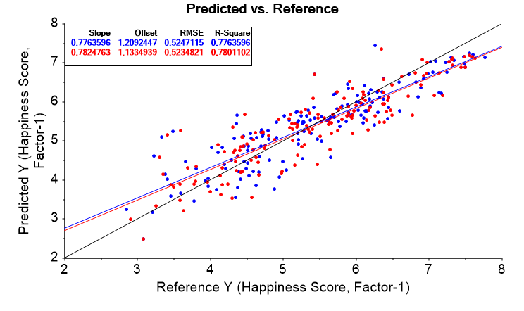
Partial Least Squares Regression
Notes:
Did not converge for 1/std weighting

Slide 20
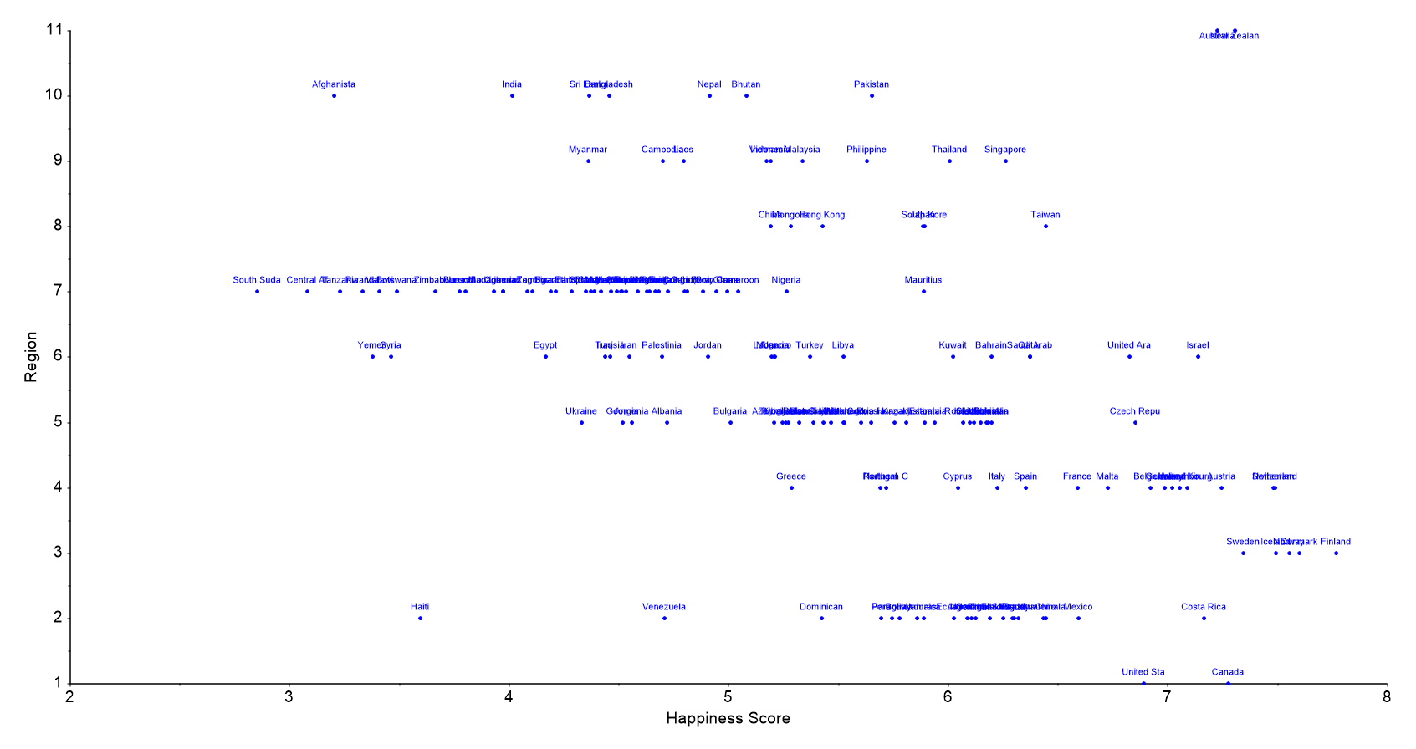
Regional Happiness
Notes:
Did not converge for 1/std weighting

Slide 21
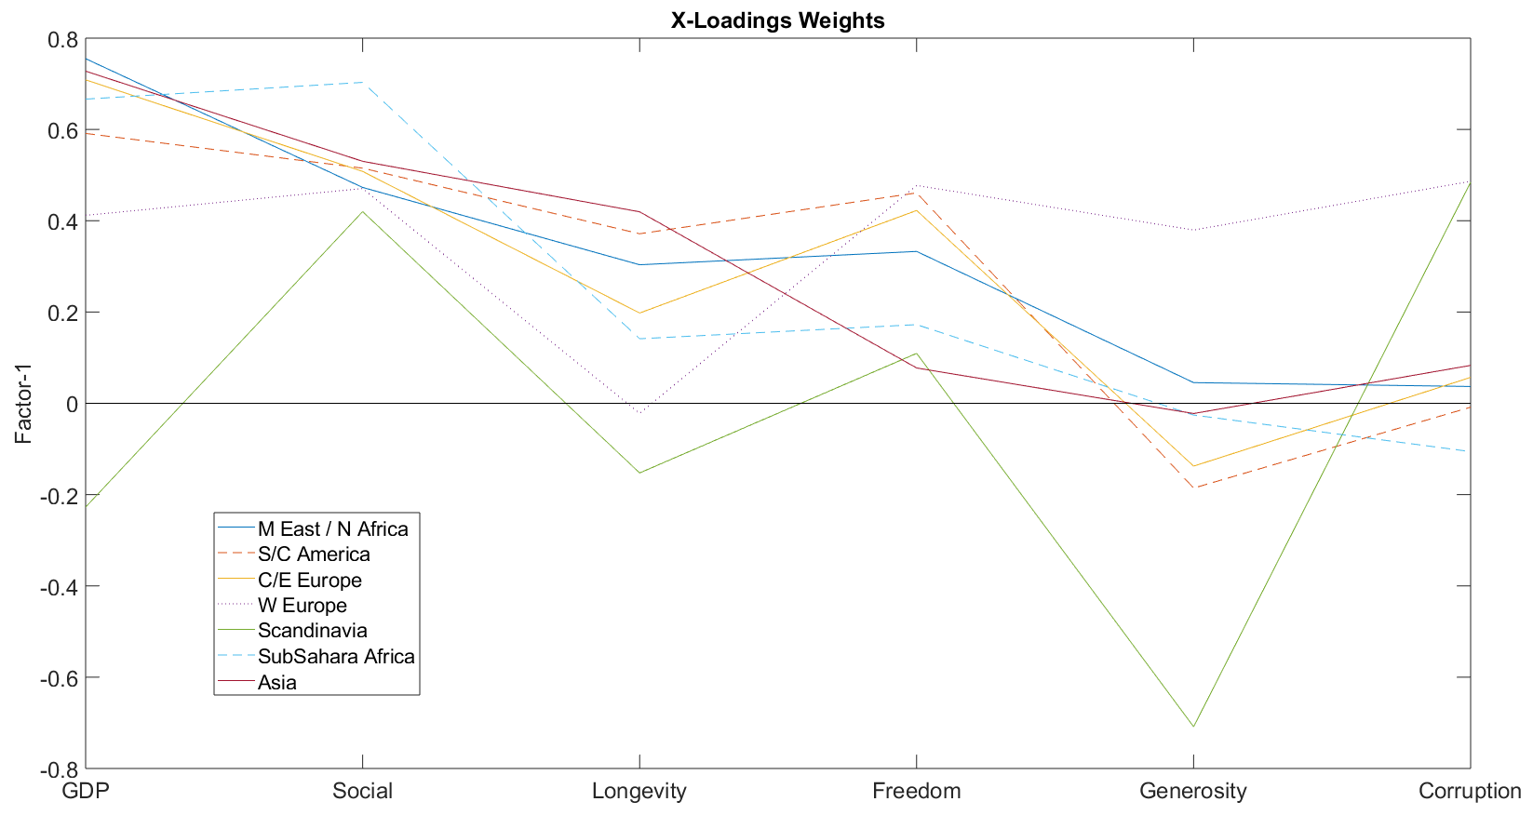
Regional Happiness
Notes:
PLSR region specific, NIPALS, equal weighting

Slide 22
Summary
 | Bias? | Ex. Var. | RMSE Cal | RMSE Val | Important factor | Comp. Time
MLR | no | 78 | 0.534 | 0.511 | social support | 0.1406318
PCR | no | 78 | 0.528 | 0.528 | GDP | 0.0937265
PLSR | no | 78 | 0.525 | 0.523 | GDP | 0.1093833
Which factors affect happiness? GDP, longevity, social support
Do these factors contribute linearly to a happiness model? 3 do at least
If the model can predict happiness, how certain is it? see above
How can this be validated? last years data
Can we predict happiness? see above
Notes:
Unbiased (residuals are random) and better fit

Slide 23
Improvements
Larger dataset (states, cities, etc.)
Regional variations on the questionnaire
Would asking different questions help the model?
Try nonlinear model, Deep Neural Network, for example
Notes:
Did not converge for 1/std weighting

Slide 24
Thank you, questions?

Slide 25
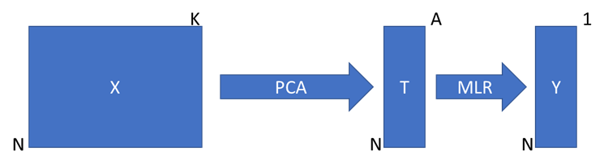
Methods: Linear
Principal Component Analysis
Principal Component Regression
Partial Least Squares Regression
Multiple Linear Regression
IDLE
PARAFAC
MLR

Slide 26
Methods: Linear
data X: rows = object, columns = variable
Linear Method | Advantages | Disadvantages
PCA | Objects: can be correlated Applications: dimensionality reduction, outlier detection, variable correlation | Variables: not considered Other: Original data lost after projection
PCR | Objects: can be correlated, good for >> 30 Variables: can be correlated, > 1 Other: Missing data is ok | Objects: > # scores Other: PCs that explain objects don’t necessarily predict variables
PLSR (NIPALS) | Objects: can be correlated, good for >> 30 Variables: > 1 Other: Missing data is ok | Can be slow, better than pcr
MLR | Objects: < 30 objects Variables: 1 Other: simple, interpretable | Objects: noise free and complete, > # variables Variables: noise free, complete, uncorrelated, independent Other: Sensitive to outliers, linear data only
IDLE
PARAFAC

Slide 27
Methods: Non-Linear
Decision Tree: graphical, used for probability and classification
Random Forest: regression / classification using averaging DTs
Support Vector Machine
Deep Neural Network

Slide 28
Methods: Non-Linear
Non-Linear Method | Advantages | Disadvantages
DT | Interpretable, req little preprocessing, automatic feature detection | Overfitting (high variance), small variation in data means different tree
RF |  | Higher bias but smaller variance, less interpretable
SVM | Text categorizing, image classification, handwriting ID, categorizing
DNN

